Slide 1
KubeVela: Make shipping applications more enjoyable
KubeVela team

Slide 2


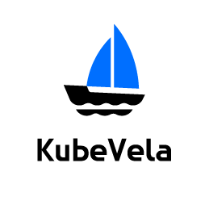

















What is KubeVela
KubeVela is a modern software platform that makes delivering and operating applications across today's hybrid, multi-cloud environments easier, faster and more reliable.
Infrastructure agnostic
Programmable
Application-centric
CI Pipeline
NEW
NEW
NEW
API
CLI
UI
GitOps
Observability
Kubernetes Multi-Clusters
Jenkins
KubeVela
Render
Orchestrate
Deploy
Manage
Clouds
Addon Catalog
NEW
...
IoT/Edge
CI
CD
Day-2 Operating
Notes:
Overview

Slide 3

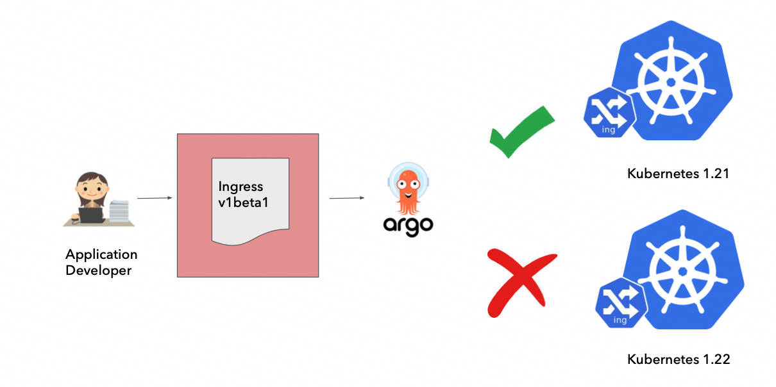
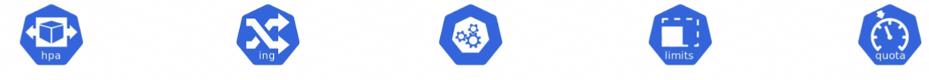
Why should I use KubeVela?
To reduce the complexity of cloud native Infrastructure.
Application Developer
？
？
？
？
？
How to set my HPA? minReplicas, maxReplicas?
Does it enough to set my SLB health check timeout 15s?
What is PDB？ What’s maxUnavailable?
How to set CPU and memory limit?
What’s my namespace quota?
Application Developer
Kubernetes and cloud complexities are exposed directly to application developers.
Kubernetes deprecations are exposed.
https://thenewstack.io/how-intuits-platform-engineering-team-chose-an-app-definition/
Notes:
Day 1 App Delivery

Slide 4
Why should I use KubeVela?
The modern application needs a hybrid/multi-cloud architecture.
Modern Application
Modern Application
RDS
ACK
SLS
ARMS
Deployment
StatefulSet
EKS
AKS
ACK
GKE
CRD Controllers
Hybrid Environment
Multi-Clusters
App Delivery not only containers but also cloud resources.
App Delivery across multi-clusters for dev/test/prod environment.
App Delivery to multi-clusters/clouds for high availability.
How to manage them in a united way?
Notes:
Day 1 App Delivery

Slide 5
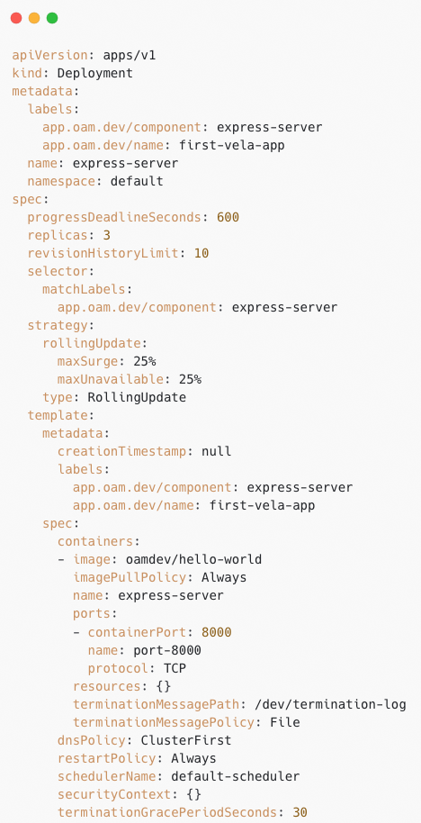
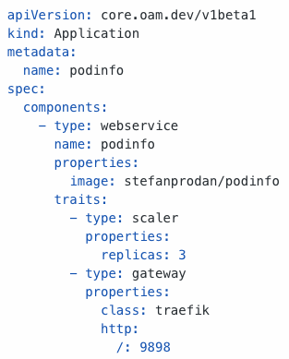
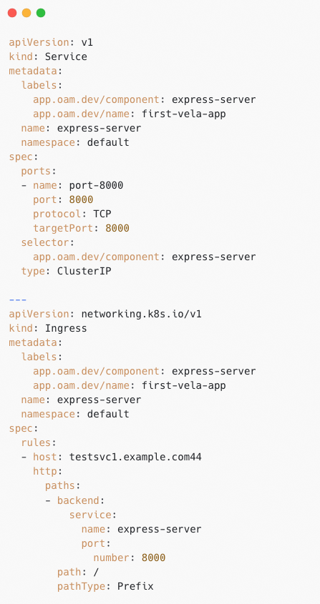
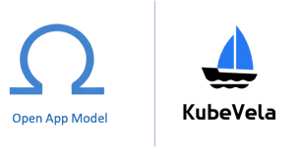
The unified model(OAM) behind KubeVela
VS
Consistent Application Model for Application Delivery.
Kubernetes Native Resource
The application delivery model behind KubeVela is Open Application Model(OAM).

Slide 6

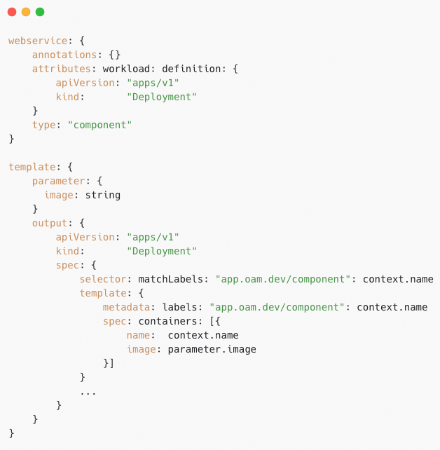
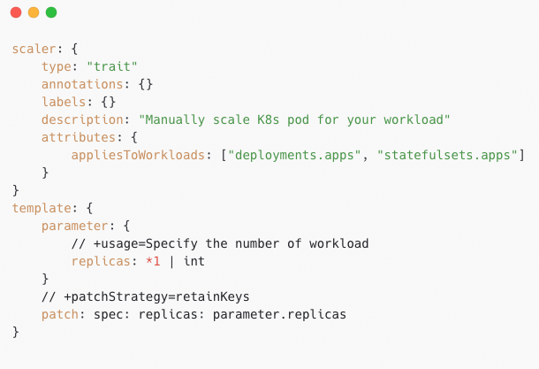
How CUE works in KubeVela? Templating
ComponentDefinition
TraitDefinition
Programmable Extensibility with CUE Configuration.
Abstraction from Best Practices.
Infrastructure Implementation agnostic.

Slide 7


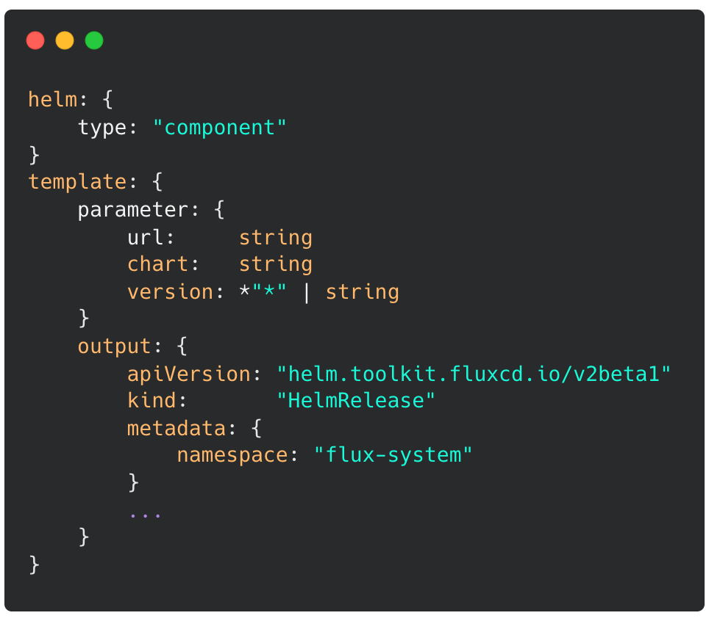

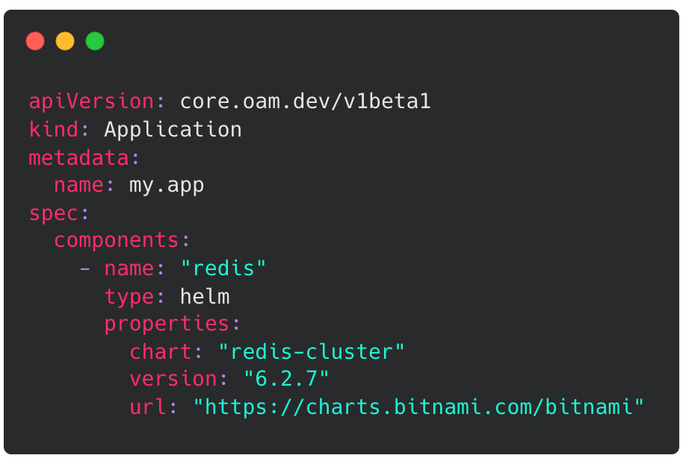

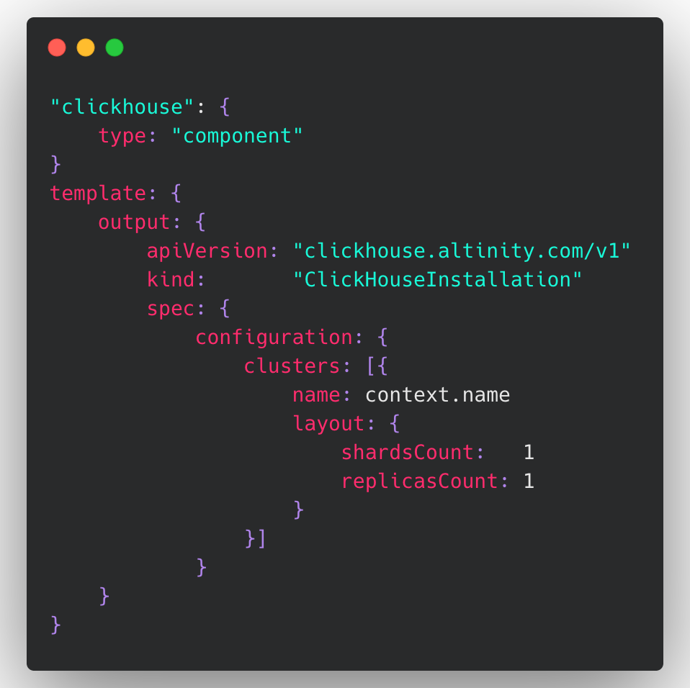


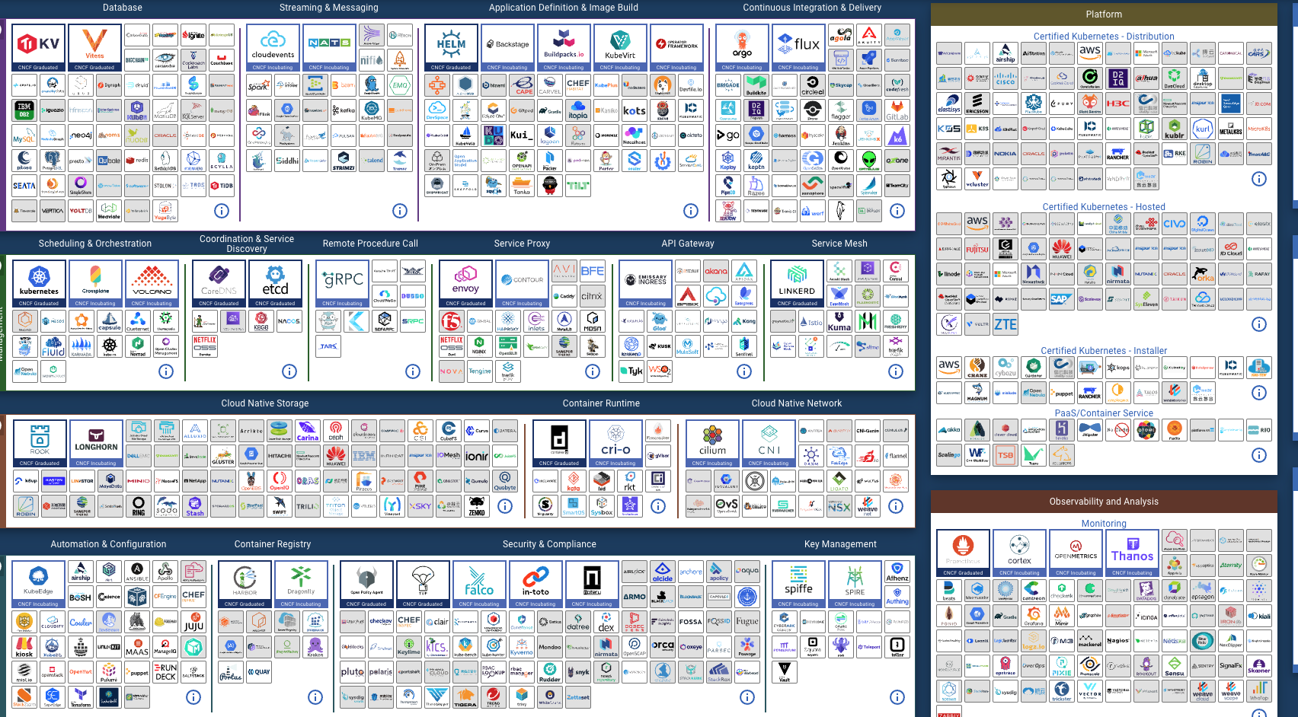
build your own extension and share with the community!
Platform Builder
OAM Definitions
Capability Providers
End User
OAM Application
FluxCD
webservice
Redis
Task
helm
Clickhouse
RDS
Clickhouse Operator
reference the definition
Register as Definition Modules
Addons are Discoverable, Reusable and easy-to-install capability bundles.
The community currently have 50+ addons already.
Addon Catalog
https://github.com/kubevela/catalog

Slide 8




The basic user workflow of KubeVela Platform
Flexible, Extensible and Programmable.
Component Types
Traits
Web Service
Autoscale
Install reusable capabilities from community
Or define your own
Cron Job
Rollout
Database
Gateway
register
Platform Team
OAM
X-Definition
Deployment
OAM
X-Definition
OpenKruise
Enforce best practices and deployment confidence
Istio
KEDA
Application
Flagger
Web Service
Gateway
Database
deploy
Terraform Controller
OAM
Application
End Users
Choose capability Templates, fill in values, assemble them into an app
e.g.
image=app
replicas=2
host=myapp.io
Enjoy PaaS-like experience
Clouds
RDS
SLB
ECS

Slide 9


Why should I use KubeVela?
The modern App Delivery needs a extensible workflow.
Declined
Or
Timeout
Data Passing
Image ID
Step-Group
Step G
Deploy To Prod A
Output
Input
If: Always
Timeout: 24h
Step A
CI
Step B
Trigger CD
Step C
Canary Deploy
Step E
More Canary Replicas
Step F
Conditional Wait
Step H
Deploy To Prod B
Step J
Notification
If: C.failed
Cluster Promotion
Manual Approval
Step I
Deploy To Prod C
Step D
Roll Back
Quality Gate
How to do canary rollout for my app?
How to promote to another cluster when my app verified?
How to trigger a notification after my delivery succeed? How to trigger other things?

Slide 10
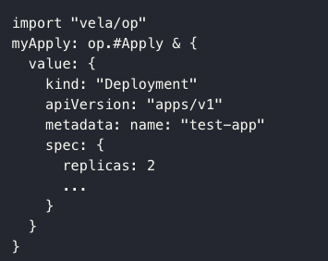
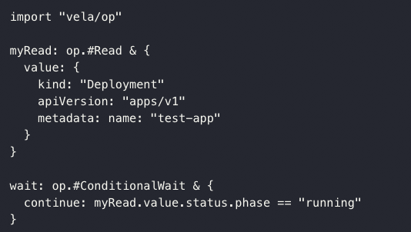
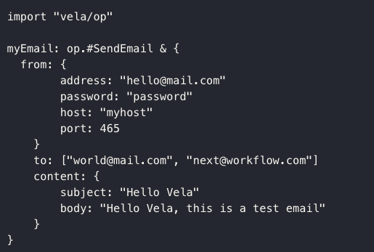
How CUE works in KubeVela? Program your Workflow Step in CUE
Declined
Or
Timeout
Data Passing
Image ID
Step-Group
Step G
Deploy To Prod A
Output
Input
If: Always
Timeout: 24h
Step A
Build Image
Step B
Push Image
Step C
Image Scan
Step E
Deploy To Dev
Step F
Conditional Wait
Step H
Deploy To Prod B
Step J
Notification
Metrics
Check
If: C.failed
Step I
Deploy To Prod C
Step D
Image Cleanup
https://github.com/kubevela/kubevela/tree/master/vela-templates/definitions/internal/workflowstep

Slide 11
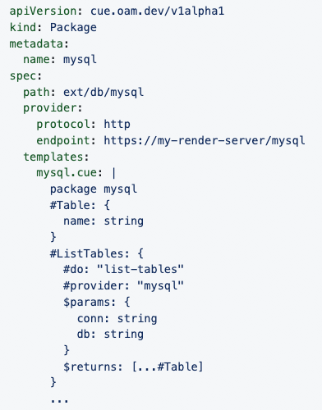
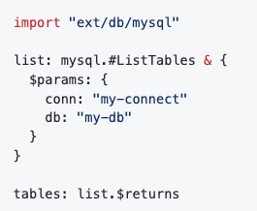






How CUE works in KubeVela? Extend with real world service
CueX
X-Definitions
Triggers
third party service
Workflow
Application
Unified App Delivery Experience
Can be written in any language
Register any third-party services as unified IaC module through CUE

Slide 12
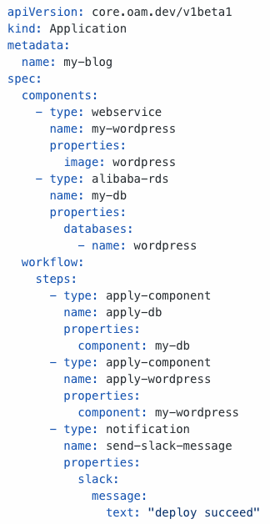


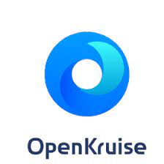




Finally, we got a unified, programable application delivery experience
Control Plane
Application
Component A
Data Input/Output
Component B
Dependency
Component C
traits
traits
traits
Terraform controller
Community addons
Runtime Level Capabilities
Clouds
Kubernetes Clusters
KubeVela Community Addons

Slide 13
Play with KubeVela

Slide 14


